Slide 1




28 MARCH, 2023
NIDHI+: Using Technology to Empower Hospitality Businesses
An initiative towards Aatmanirbhar Bharat

Slide 2









NIDHI+: Using Technology to Empower Hospitality Businesses
Overview
NIDHI+ Overview
Snapshot of the System
Modules in NIDHI+
Tourism Service Provider Module
What makes NIDHI a robust system?
State Centric Platform: Partnership with States
Tourist Feedback
OTAs Integration
Destination Centric Services

Slide 3



NIDHI⁺ Overview
What it is
Who can use it
What are the benefits
A National Digital Tourism Platform of all relevant stakeholders of Tourism & Hospitality Industry
An authentic validated Database
An end-to-end Digitalized System to ensure Ease of Doing Business; improve delivery of services, benefits and incentives
Foreign & Domestic travellers
Accommodation Units (like Hotels, B&B, Homestays, Motels, etc.)
Tourism Service Providers (Travel Agents, Tour Operators, etc.)
Food Business Operators (Standalone Restaurants, etc.)
Online Travel Aggregators (OTAs)
Convention Centres
Any other Tourism/Hospitality Stakeholder
Visitors/tourists to access information regarding service providers, destinations and attractions at one place
Visibility to service providers at National & International level
Seamless integration across Govt & Private stakeholders using unique NIDHI ID
Promote single platform for various quality certifications
Encourage quality of service through feedback and ratings
Aligned with Hon’ble PM’s Vision of an Aatmanirbhar Bharat

Slide 4
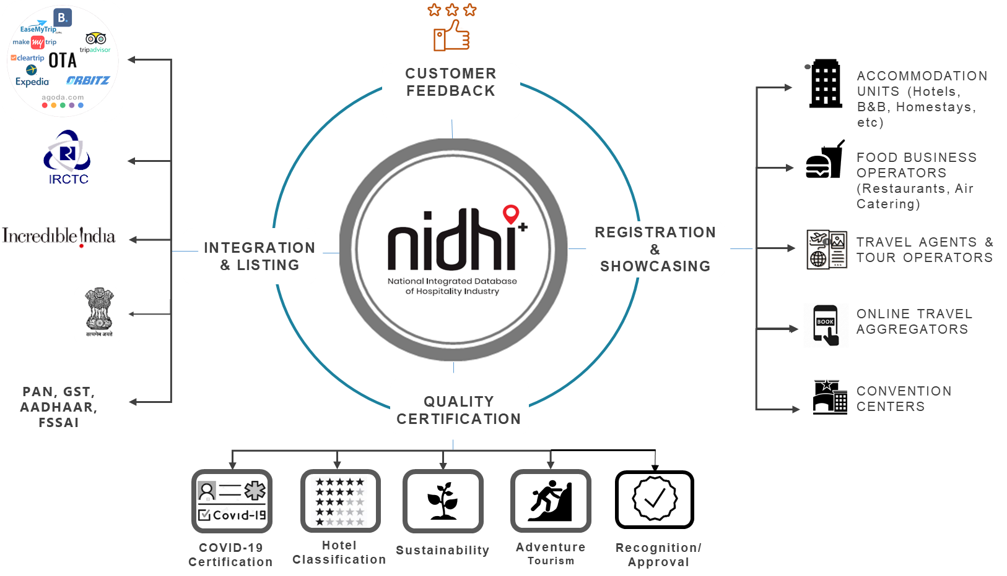
Snapshot of the System

Slide 5



Modules in NIDHI+ (1/3)
Module
Key functioning
Salient Features
Registration
Basic information captured
Final Verification by State Nodal Officer
Unique NIDHI ID for each registered entity
PAN/GST/FSSAI validation at unit/user side
Showcasing
  Basic information, photographs & documents uploaded
  Scrutiny by State Nodal Officer
  Post approval Entity’s page is displayed on NIDHI
  Registered Entities can showcase the facilities and services
  Link of OTAs to book services on which unit is listed
  This service is free for all registered entities
Feedback
Customers/Tourists can provide a feedback of their experience with service providers
The same will be displayed in the showcasing page on NIDHI+ portal

Slide 6



Modules in NIDHI+ (2/3)
Module
Key functioning
Salient Features
Classification
  Registered Entities can apply for relevant certification as available
  Provision of remote & 3rd party assessments
  Certification Categories include Star Classification, Approvals, Recognitions, Sustainability Certification etc.
  Auto-generated report and Certificate after assessment
  Use of Mobile application in site-assessments with geo-tagging & time-stamping
Display of Certification badges of Units on OTA platforms
Introducing Sustainability Certification based on STCI

Slide 7
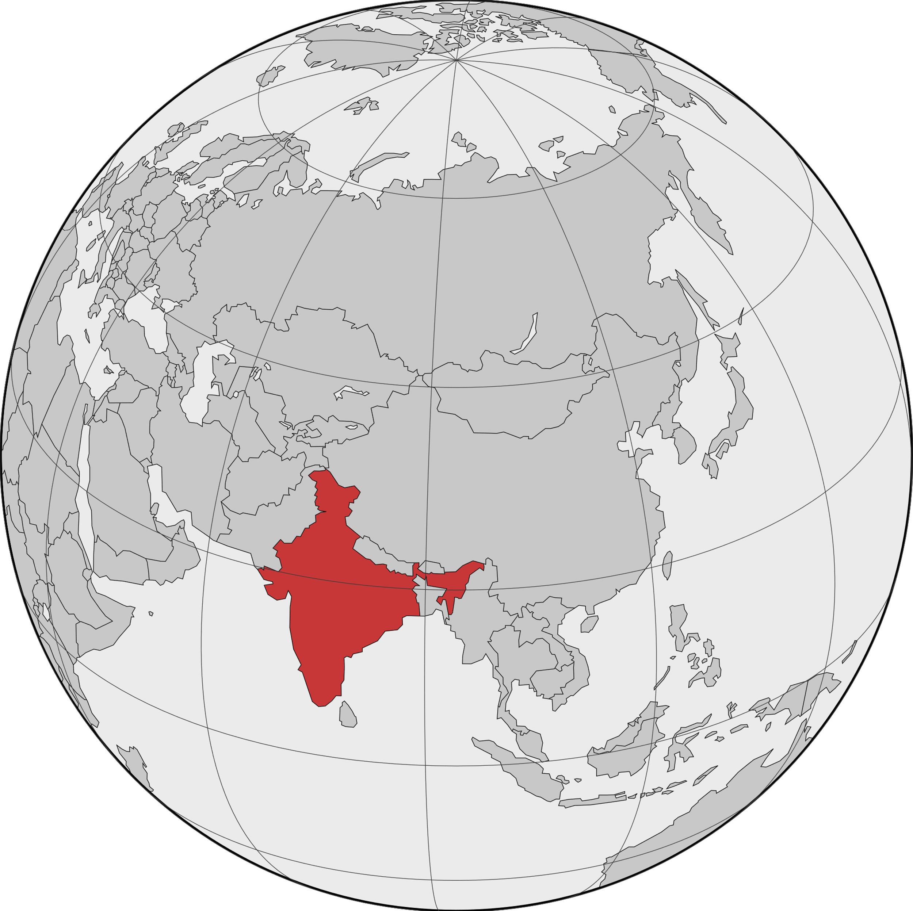


Modules in NIDHI+ (3/3)
Module
Key functioning
Salient Features
Destination
  City Wise input
  Description
  How to reach
  Main attractions of city will be shown on city wise destination page
Attraction
  Input in multiple categories like: Art, Beach, Culture, Education, Heritage, Hill, Museum, Nature/wildlife, Religious, Sports etc.
  Description
  Venue
  Pictures
Events
  Input in multiple categories like: Award functions, Conference/Seminars, Fairs & festivals, MICE, Music & Dance, Trade shows etc.
  Description
  Venue
  Contact details
  Brochure
  Registration link

Slide 8
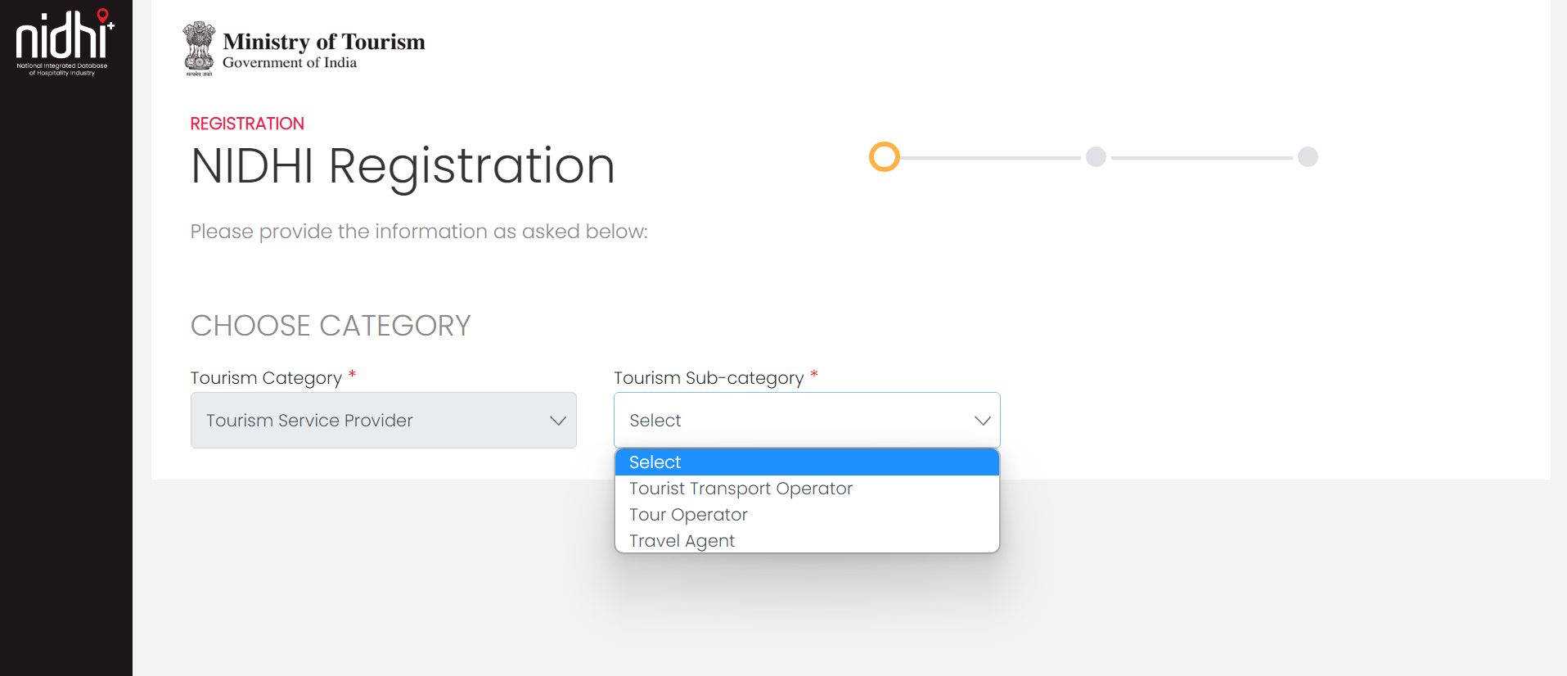
Tourism Service Provider Module (erstwhile eTravelTrade)
Registration & Recognition module now live
End-to-end digitalized system with use of mobile application for assessment wherever applicable
Data Migration in progress

Slide 9
What makes NIDHI a robust system?
VERIFICATION AT MULTIPLE STAGES
PAN/GST, Email, Mobile Number, State Nodal Officers
UNIQUE NATIONAL IDENTIFICATION
NIDHI ID issued after verification
SHOWCASING OF ENTITIES
Registered entities can showcase their services free
CONSOLIDATED DATABASE
Access to information on registered, showcased & certified entities
MORE STAKEHOLDERS
Not only accommodation units, but also tourism service providers, food business operators etc.
INTEGRATION
Provision to integrate NIDHI+ Systems with States, OTA including Digilocker and other stakeholders
DASHBOARD
Comprehensive dashboard for States to know about the registered entities in their region
MARKETING TOOL
Certified entities can use the platform as a marketing tool; for branding and information dissemination
CREDIBILITY
With multiple verification and assessments, there will be enhanced credibility and visibility

Slide 10
State Centric Platform: Partnership with States
VERIFICATION
All verifications, wherever required, to be approved by the States
OFFICER LOGINS
State Nodal Officers, and District level officers, can be configured in the system
STATE SPECIFIC MODULE
State Administration Module for dashboard & their respective data
INPUT FIELDS
Best practices of the states have been included in various modules
INTEGRATION
Provision to integrate NIDHI+ Systems with States

Slide 11
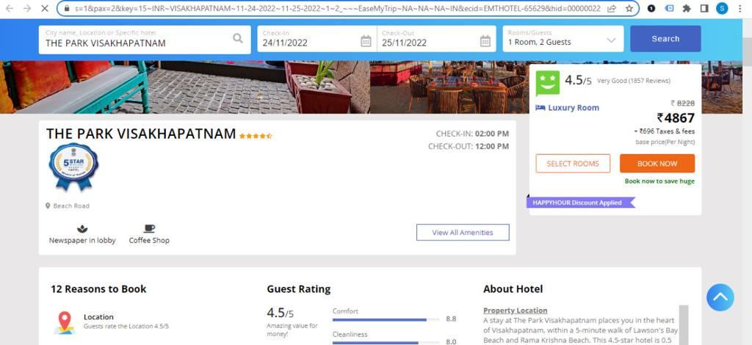
OTAs – Classified Hotels connected with Destination
EaseMyTrip – Live on Web module
Ministry of Tourism Badge
Certification Badges displayed on OTA platform for classified units
Provides authenticity as well as visibility to Certified units
Highlighted Red Box – Certification Badges by Ministry of Tourism

Slide 12
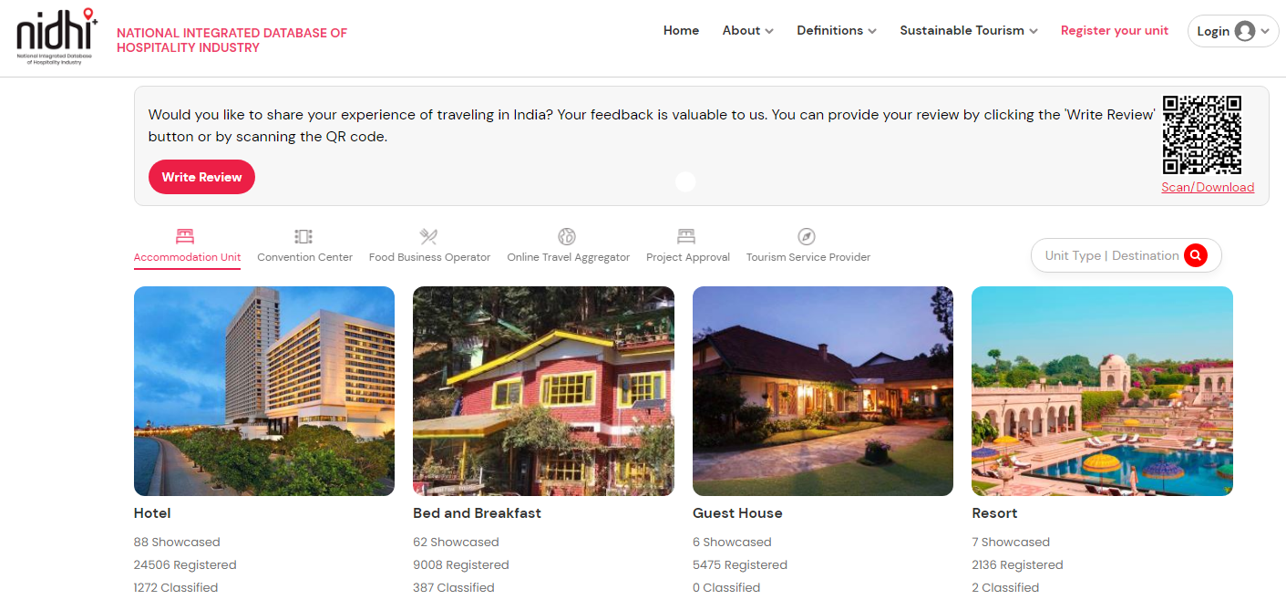
Feedback (Foreigner / Domestic / Unit)
New
QR code based feedback from Domestic and international Tourists
Covering major aspects of Travel experience
QR code to be made available at major tourist touchpoints
Can also be utilized at all strategic G20 locations

Slide 13
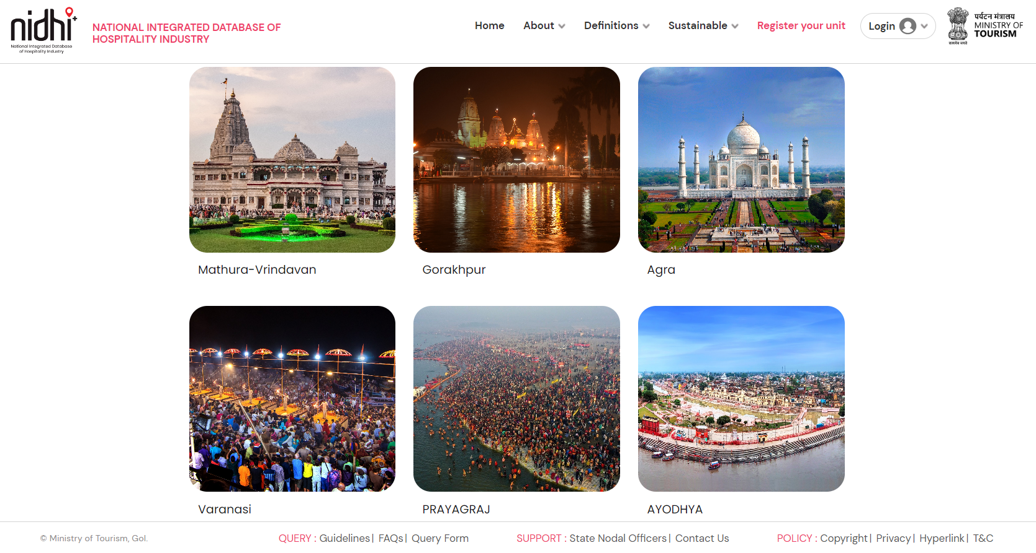
Destination Centric Services (1/6)
Destinations
Tourists can access the digital repository of destinations by intuitive search

Slide 14
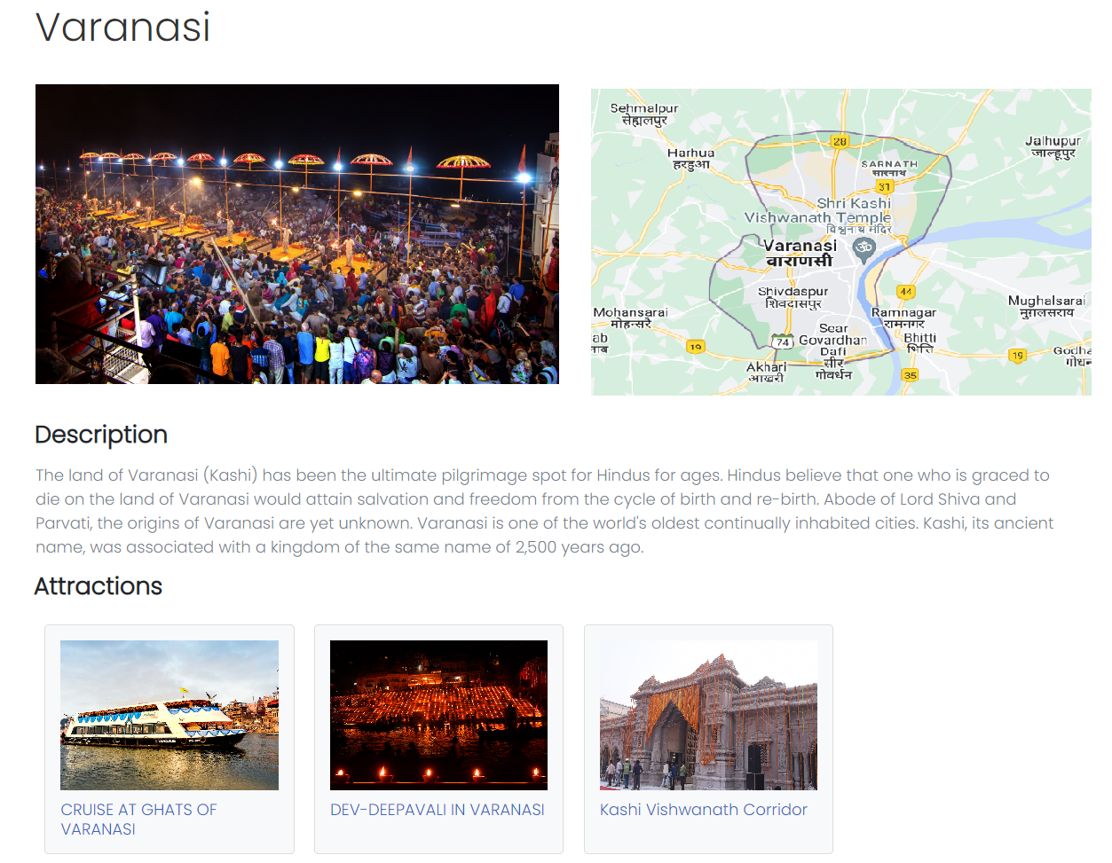
Destination Centric Services (2/6)
Connected Attractions within Destination
Attractions mapped with Destination. Online booking link option available for applicable attractions.

Slide 15
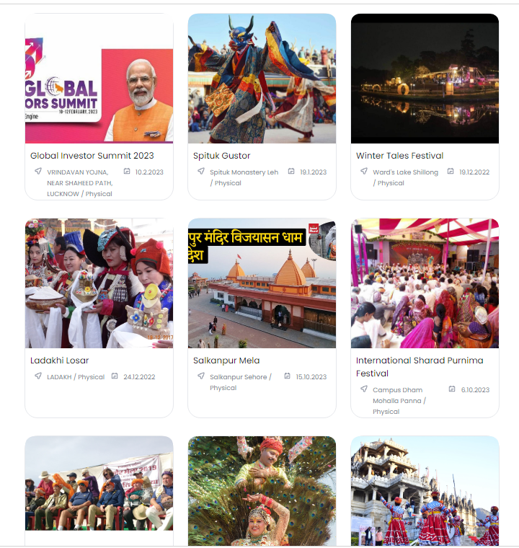
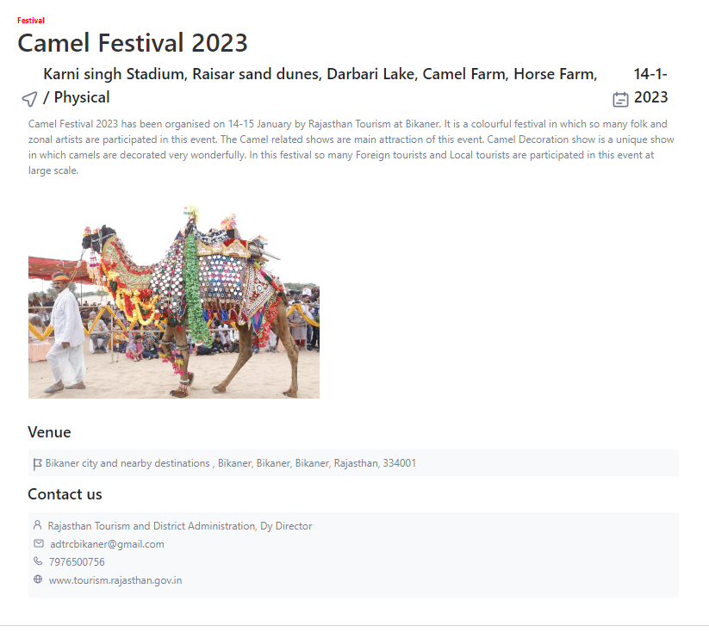
Destination Centric Services (3/6)
Connected Events

Slide 16
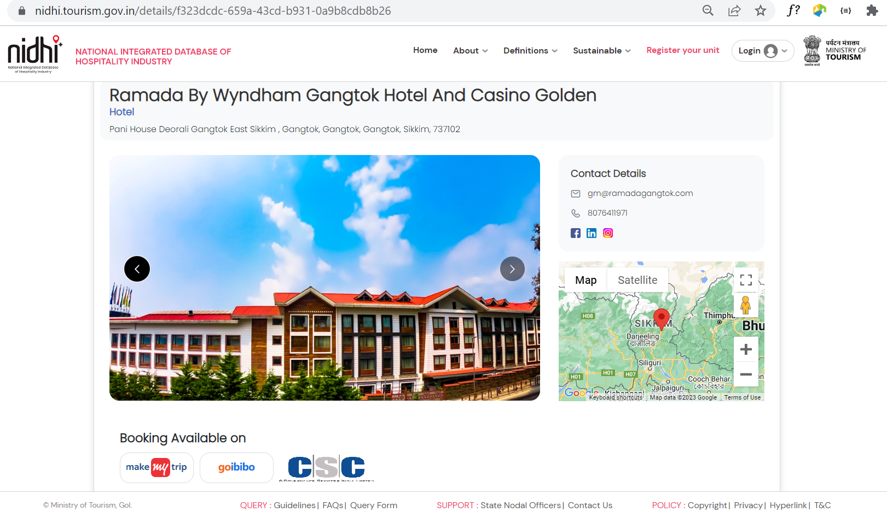
Destination Centric Services (4/6)
Showcased Accommodation Units
Units can showcase their services on NIDHI+ portal after registration
Option to provide link of their booking page on various OTAs
Provides national visibility to units on NIDHI+
Proposed Feature
For units not having online presence, it can be facilitated through CSC

Slide 17
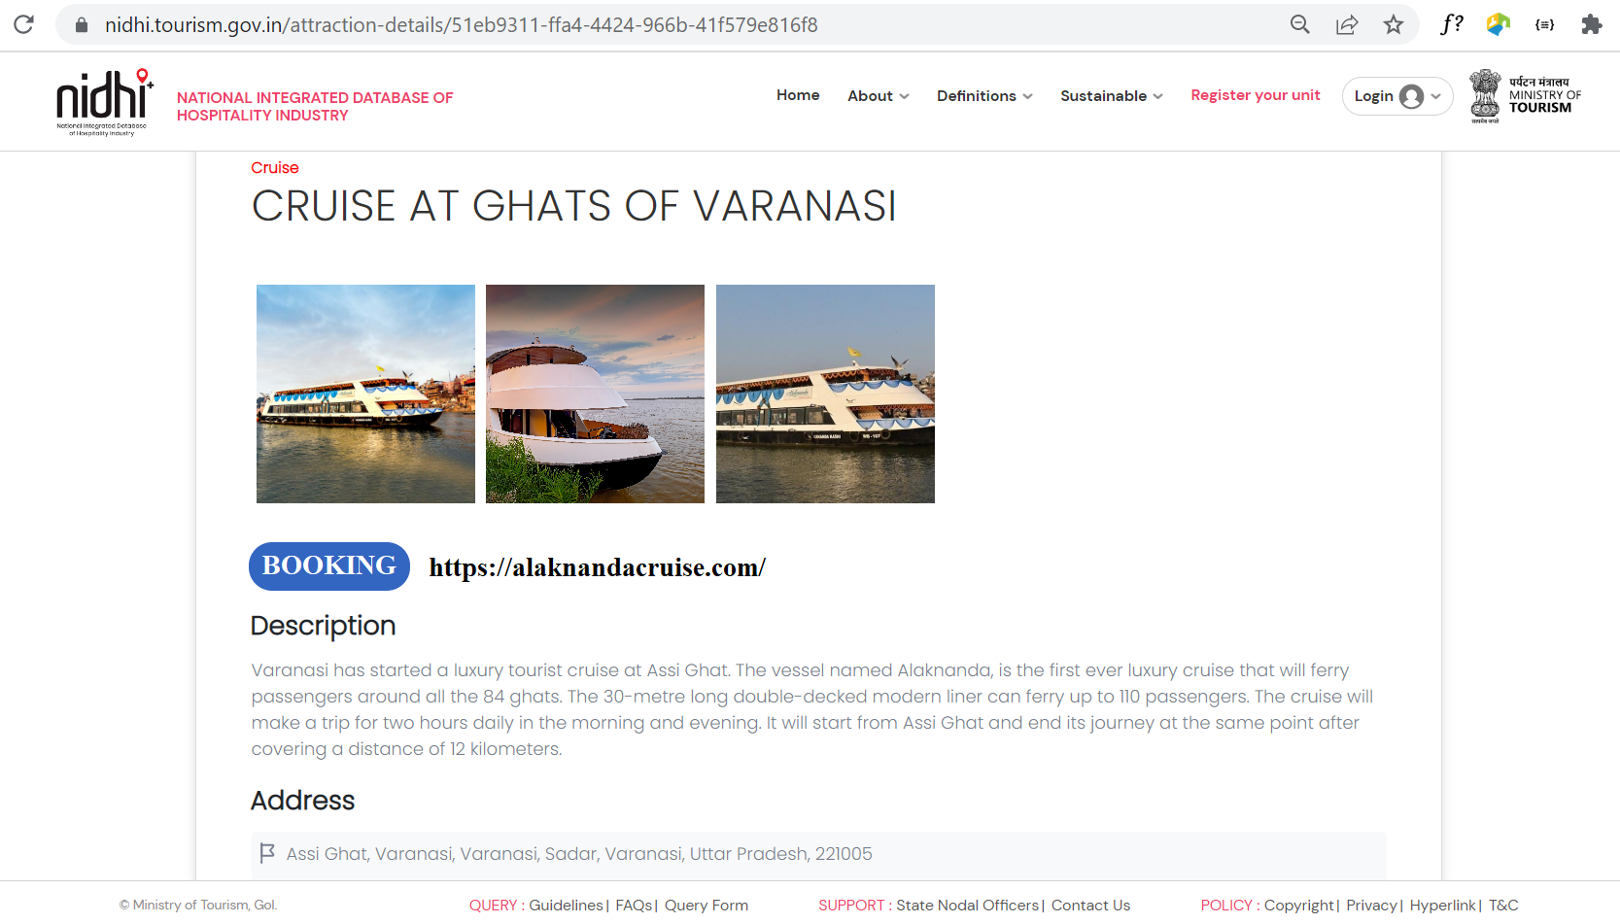
Destination Centric Services (5/6)
Booking links for connected Attractions
Proposed Feature
River Cruise, Adventure Tourism, etc options will be available for each destination. Online booking link option available for applicable attractions.

Slide 18
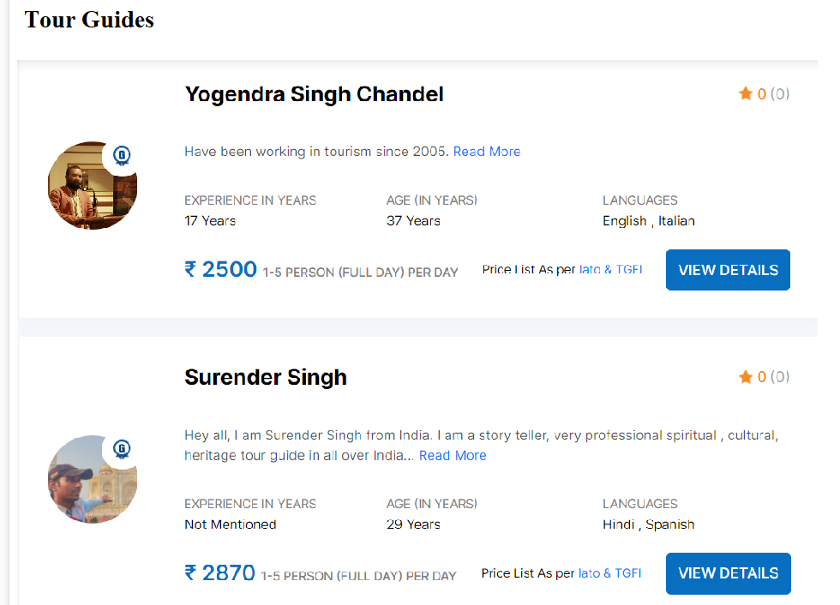
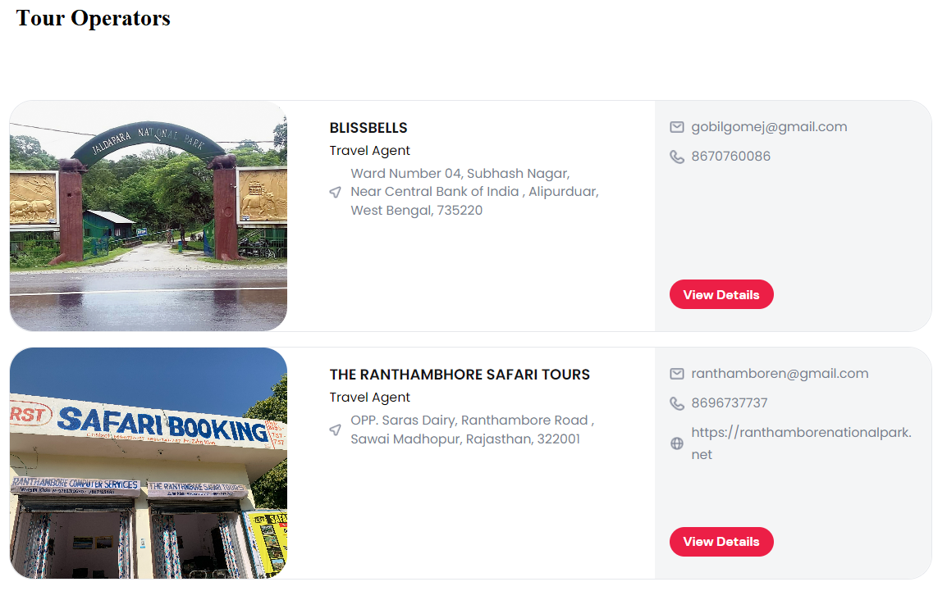
Destination Centric Services (6/6)
Tourist Guides, Tour Operators linked to Destinations
Proposed Feature

Slide 19
28 MARCH, 2023
THANK YOU!
An initiative towards Aatmanirbhar Bharat

